Slide 1
Analyzing the Performance of Classifiers on Identifying Diabetic Patients
By: Zach Petroff, Ben Rieke and Connor Smith

Slide 2
Problem Statement
We are trying to determine which attributes are the most influential in determining whether a particular individual has diabetes.
Furthermore, we are interested in determining how effective these attributes are in correctly determining if an individual has diabetes.
Additionally, we will also look to determine which classification method provides the best performance in this prediction.

Slide 3

Data
Retrieved from UCI machine learning repository
16 features
15 discrete features and one continuous feature
520 instances
About 65% positive and 35% negative

Slide 4
Data Preparation
Deleted rows with missing attributes
The correlation of each feature to the class was found
The five features with the highest correlation were chosen (> .3)
Data was transformed into 1’s and 0’s so that is easier to use
~20% reserved for validation
Feature | Description | Correlation
Gender | Reported gender | .44
Polyuria | Abnormal amount of urine production | .67
Polydipsia | Extreme thirst | .65
Sudden Weight Loss | If the individual experienced sudden weight loss | .44
Partial Paresis | Muscle weakening | .43

Slide 5
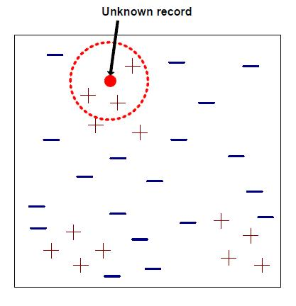
Nearest Neighbor Classifier
Classification works by identifying the distances between data to be classified and k neighbors.
The highest number of class instances in neighbors decides classification of the point

Slide 6
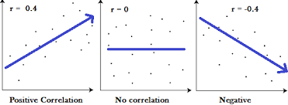
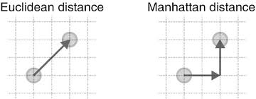
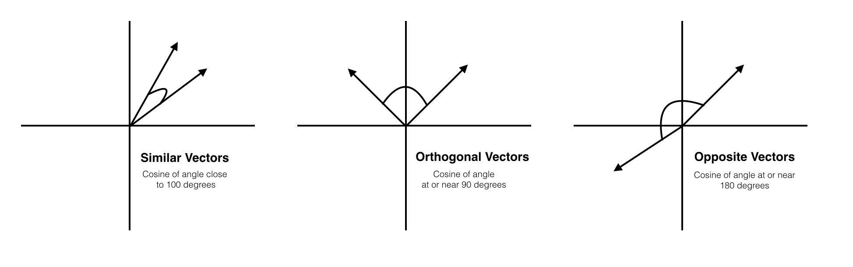
Distance Methods
Manhattan Distance
𝚺 |x_{i} - y_{i}|
Euclidean Distance
√Σ(x_{i} - y_{i})²
Pearson Distance
1 - Corr(x, y)
Cosine-Similarity
dot(x, y) / ||x|| * ||y||

Slide 7
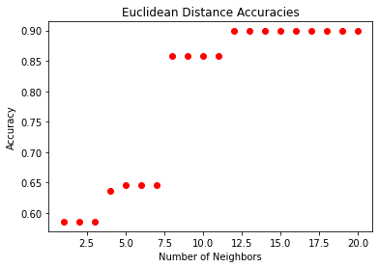
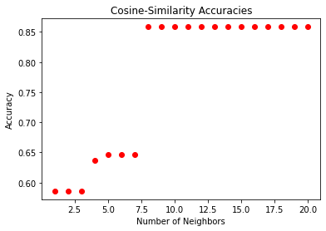
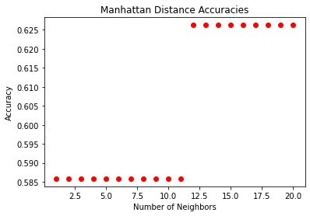
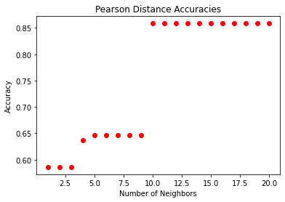

Optimization
Euclidean & Manhattan distance outperform Pearson & Cosine-Similarity distance
Manhattan distance is slightly more efficient
Optimal Number of Neighbors is 12
Highest Accuracy ~90%

Slide 8
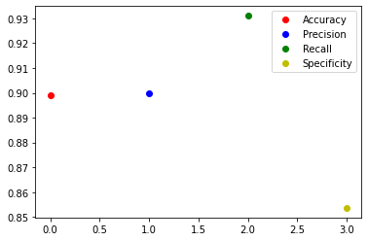
Metrics
High recall, so the model is good at classifying individuals that have diabetes.
Low specificity, so the model is not good at classifying individuals who do not have diabetes.

Slide 9
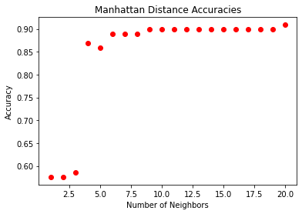
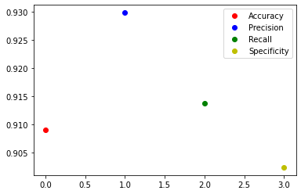
Further Optimization
By reducing the amount of positive data, the hope is to reduce the bias of the network.
Reducing the data allowed us to get a slightly higher accuracy (~91%), and also leveled out the recall and specificity.

Slide 10
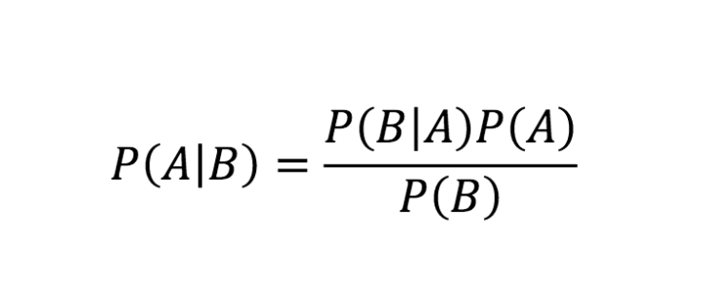
Bayes Models
Bayes optimal
vs
Naive Bayes

Slide 11
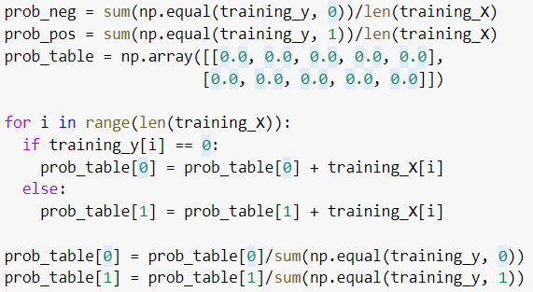
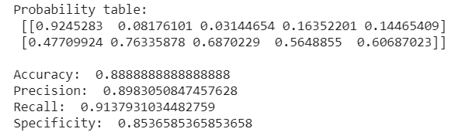
Naive Bayes
 | Gender=M | Polyuria | Polydipsia | Weight loss | Paresis
Negative | .9245283 | .08176101 | .03144654 | .16352201 | .14465409
Positive | .47709924 | .07633587 | .6870229 | .5648855 | .60687023

Slide 12
Can we do better?
Almost always, no.
Naive Bayes assumes independence of features.
Otherwise, it is nearly always impossible to accurately model probability of all possible combinations of features.
Thus, Bayes optimal is almost never used in practice.
HOWEVER...

Slide 13
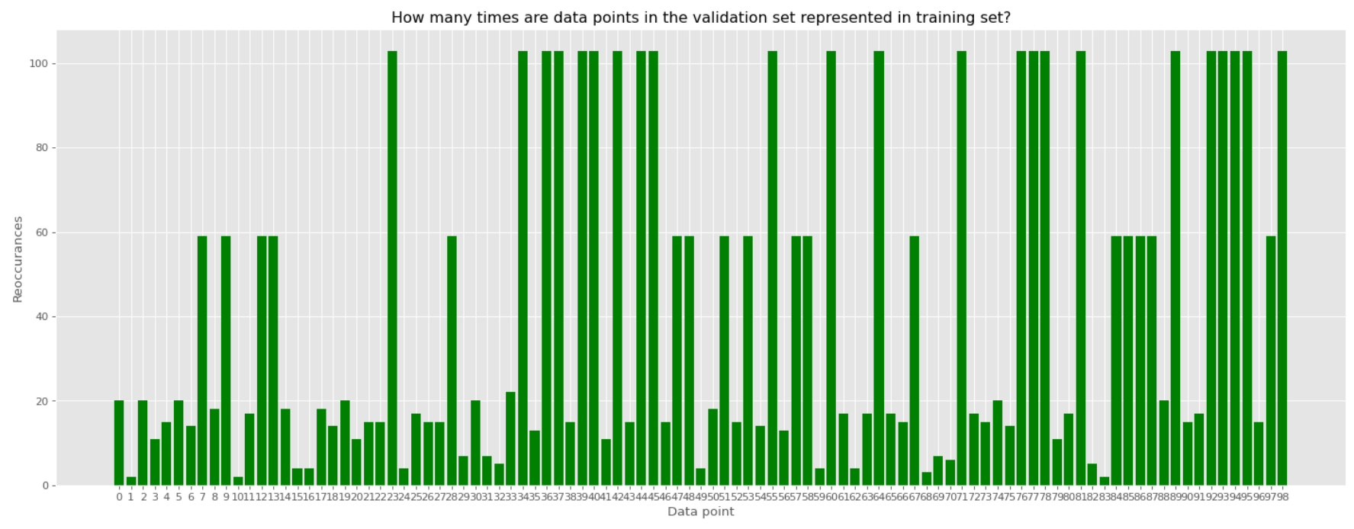
We can do Bayes Optimal!
Training data n=421
5 binary features = 2^5 = 32 possible combinations ‘
With even distribution, there should be around 13 representations of each combination in dataset.

Slide 14
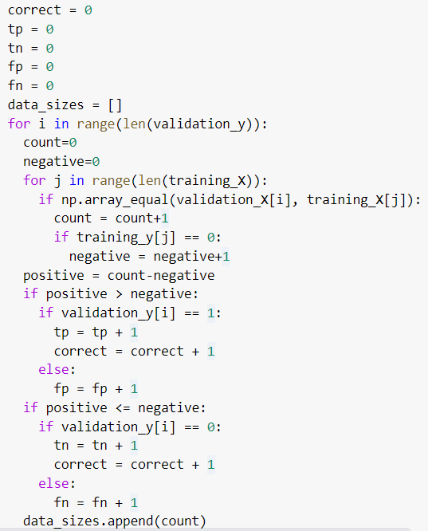
Bayes Optimal
Rather than building table, we can train model on each instance as we go - easy implementation but slow with large datasets.
For each data point in validation set,
Find every point in training set with matching features and total positive and negative classifications
If #positive > #negative, classify as positive and vice versa
Compare to validation y to determine evaluation metrics

Slide 15
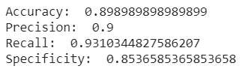
Results
Naive Bayes
Bayes optimal
Bayes Error is irreducible, so with good data we should get good results

Slide 16
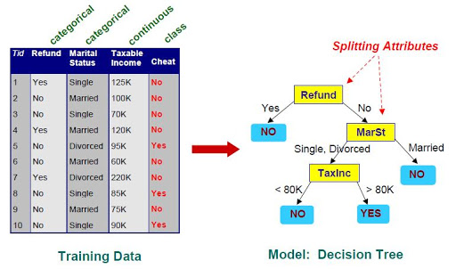
Tree-Structured Classifier
Goal is to build a decision tree based on a set of training data, such that data values are assigned class labels based on the combination of predictor variable values. This method is used to build a classification tree when predictor variables can take on a discrete number of values.
A regression tree is made from a set of training data based on the mean values of combinations of predictor variables when the predictors are able to take on a continuous set of values.

Slide 17
Classification Trees
For this data set, a classification tree is used because the predictors are only able to assume a binary value.
fit = rpart(class ~ Gender + Polyuria + Polydipsia + sudden.weight.loss + partial.paresis, data = training_data, method = "class", parms = list(split = 'gini'))
n= 421
node), split, n, loss, yval, (yprob)
* denotes terminal node
1) root 421 159 1 (0.37767221 0.62232779)
2) Polyuria< 0.5 208 62 0 (0.70192308 0.29807692)
4) Gender>=0.5 162 28 0 (0.82716049 0.17283951)
8) Polydipsia< 0.5 140 11 0 (0.92142857 0.07857143) *
9) Polydipsia>=0.5 22 5 1 (0.22727273 0.77272727) *
5) Gender< 0.5 46 12 1 (0.26086957 0.73913043) *
3) Polyuria>=0.5 213 13 1 (0.06103286 0.93896714)

Slide 18
Results
On training data…
Accuracy= 0.9026128
Precision = 0.8932384
Recall = 0.9580153
Specificity = 0.8113208
On new data…
Accuracy = 0.8585859
Precision = 0.8235294
Recall = 0.9655172
Specificity = 0.7073171

Slide 19
Pruning?
Pruning is not needed for this tree because pruning is typically reserved for models that may become prone to overfitting.
Models that are overfit generally contain many parameters which this model does not.
A pruning process would likely not change the model at all.

Slide 20
Does Pruning Make a Difference?
fit = rpart(class ~ Gender + Polyuria + Polydipsia + sudden.weight.loss + partial.paresis, data = training_data, method = "class", parms = list(split = 'gini'))
n= 421
node), split, n, loss, yval, (yprob)
* denotes terminal node
1) root 421 159 1 (0.37767221 0.62232779)
2) Polyuria< 0.5 208 62 0 (0.70192308 0.29807692)
4) Gender>=0.5 162 28 0 (0.82716049 0.17283951)
8) Polydipsia< 0.5 140 11 0 (0.92142857 0.07857143) *
9) Polydipsia>=0.5 22 5 1 (0.22727273 0.77272727) *
5) Gender< 0.5 46 12 1 (0.26086957 0.73913043) *
3) Polyuria>=0.5 213 13 1 (0.06103286 0.93896714)
printcp(fit)
CP nsplit rel error xerror xstd
0.528302 0 1.00000 1.00000 0.062562
0.138365 1 0.47170 0.50314 0.050627
0.075472 2 0.33333 0.38365 0.045423
0.010000 3 0.25786 0.25786 0.038260
best alpha (where xerror is minimized) is at CP = 0.01
fit_optimal = prune(fit,cp = alpha)
n= 421
node), split, n, loss, yval, (yprob)
* denotes terminal node
1) root 421 159 1 (0.37767221 0.62232779)
2) Polyuria< 0.5 208 62 0 (0.70192308 0.29807692)
4) Gender>=0.5 162 28 0 (0.82716049 0.17283951)
8) Polydipsia< 0.5 140 11 0 (0.92142857 0.07857143) *
9) Polydipsia>=0.5 22 5 1 (0.22727273 0.77272727) *
5) Gender< 0.5 46 12 1 (0.26086957 0.73913043) *
3) Polyuria>=0.5 213 13 1 (0.06103286 0.93896714) *
Notes:
Pruning does not matter in this example.

Slide 21
Comparing the Classifiers
The KNN and Bayes’ classifiers both had slightly higher accuracy and precision than the classification tree. This means the KNN and Bayes’ classifiers performed better at correctly identifying all individuals and at finding that most individuals classified as diabetic were truly diabetic.
The classification tree had the highest recall rate which means that the classification tree is the best for correctly identifying the most diabetic individuals among all diabetic individuals.
The KNN and Bayes’ classifiers had a similar specificity rate that was much higher than the classification tree. This means that those classifiers are better at correctly identifying healthy individuals
Notes:
Accuracy = (TP+TN)/(TP+FP+FN+TN)
Precision = TP/(TP+FP)
Recall = TP/(TP+FN)
Specificity = TN/(TN+FP)

Slide 22
In Conclusion...
The Bayes’ classifiers and the KNN classifier performed very similarly.
These classifiers also yielded high accuracy, precision, and specificity rates (> 0.85)
The tree structures classifier however yielded a very high recall rate (roughly .96)
In practice, a Bayes’ classifier or KNN classifier would perform very well generally for correctly identifying individuals as diabetic or not.
If the task was to ensure that for all diabetic individuals, the greatest number among that group were correctly identified, then the classification tree would produce the best results.
Notes:
Remember to take questions.

